Slide 1
Machine Learning
Lecture 11

Slide 2
Why we need Regularization? The problem of overfitting
Source: https://www.coursera.org/learn/machine-learning

Slide 3
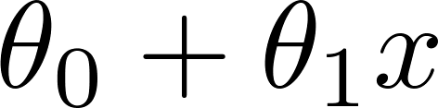
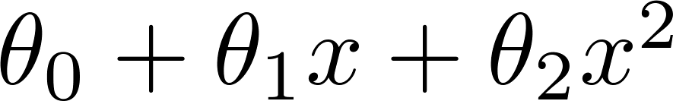
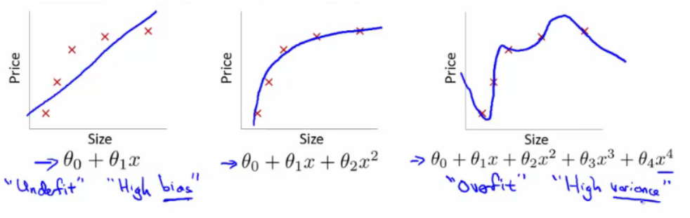
Example: Linear regression (plot prices)
Price
Price
Price
Size
Size
Size

Slide 4
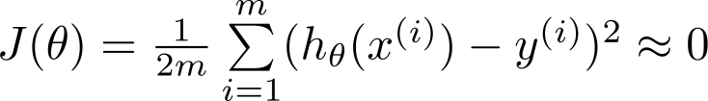
Overfitting: If we have too many features, the learned hypothesis may fit the training set very well ( ), but fail to generalize to new examples (predict prices on new examples).
Underfitting: occurs when a machine learning model is too simple to capture the underlying structure of the data, resulting in poor performance on both training and testing datasets. It is characterized by high bias and low variance, indicating the model failed to learn the dominant trends.

Slide 5
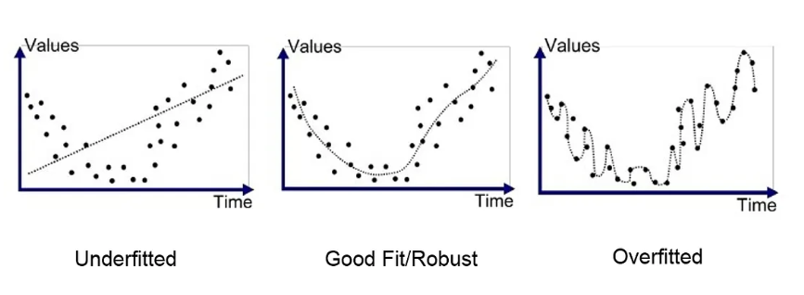

Slide 6
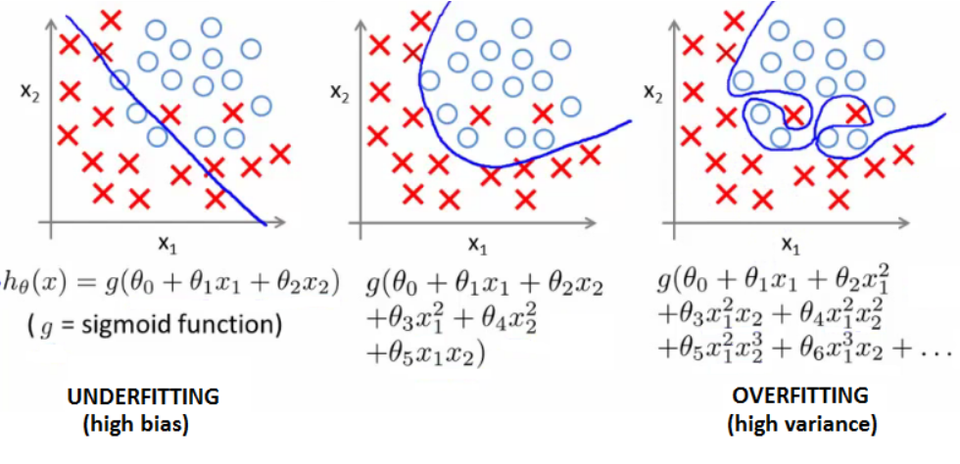
Example: Logistic regression

Slide 7






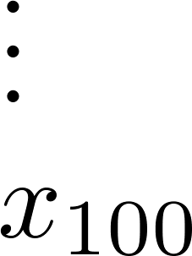
Addressing overfitting:
size of house
no. of bedrooms
Price
no. of floors
age of house
average income in neighborhood
Size
kitchen size

Slide 8
Addressing overfitting:
Options:
Collect more data
Increasing the size of the training dataset
Data Augmentation
When acquiring new data is difficult, existing data can be artificially expanded by applying random transformations (e.g., rotating, flipping, or scaling images; synonym replacement for text). This increases the diversity of the training data.
Reduce number of features
Feature selection
Manually select which features to keep
Feature selection algorithm
Regularizations
Keep all the features, but reduce magnitude/values of parameters.
Works well when we have a lot of features, each of which contributes a bit to predicting

Slide 9
Regularization
Source: https://www.coursera.org/learn/machine-learning

Slide 10
Regularization
Regularization is a crucial machine learning technique used to prevent overfitting by adding a penalty term to the loss function, encouraging simpler models that generalize better to new data.
It reduces model complexity by shrinking coefficient magnitudes towards zero, balancing bias and variance.

Slide 11


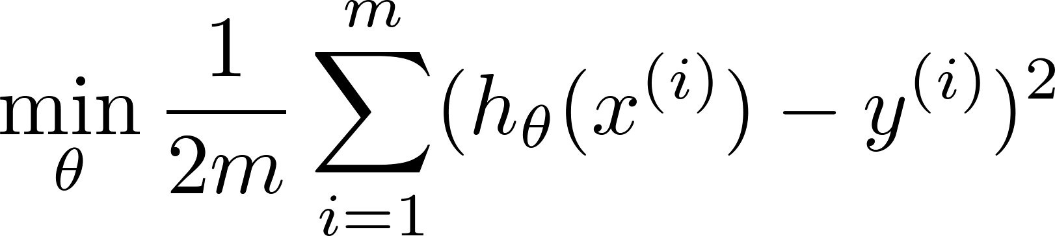
Intuition
Price
Price
Size of house
Size of house
Suppose we penalize and make , really small.

Slide 12
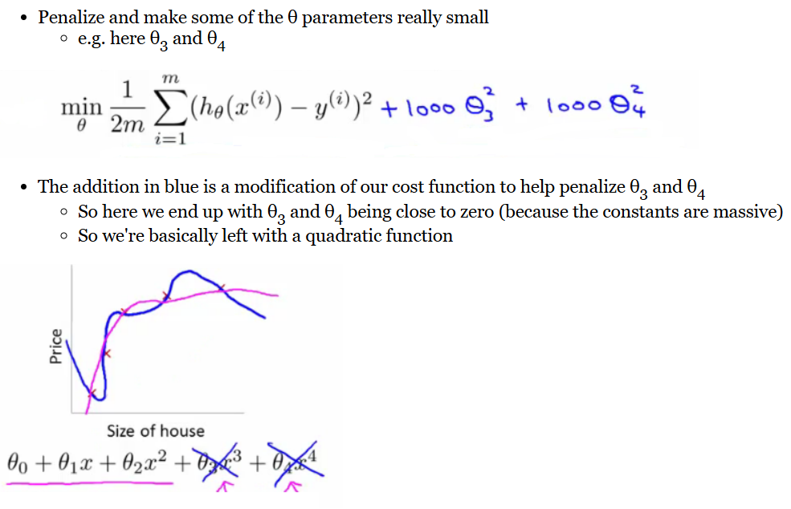

Slide 13
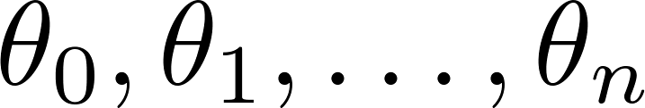
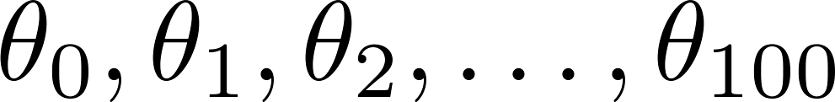
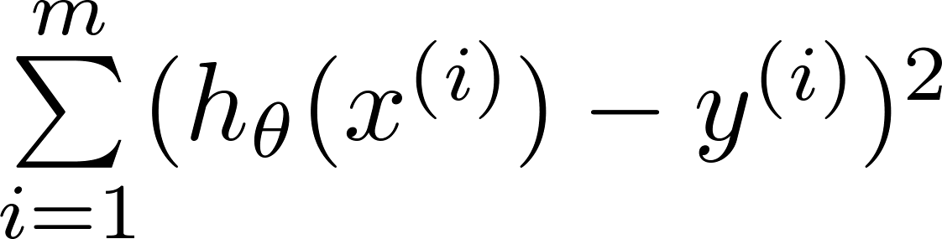
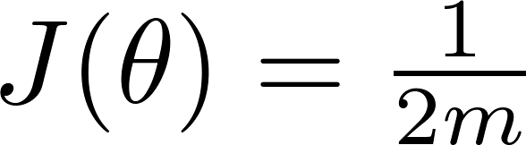
Regularization.
Small values for parameters
“Simpler” hypothesis
Less prone to overfitting
Plot Price:
Features:
Parameters:

Slide 14
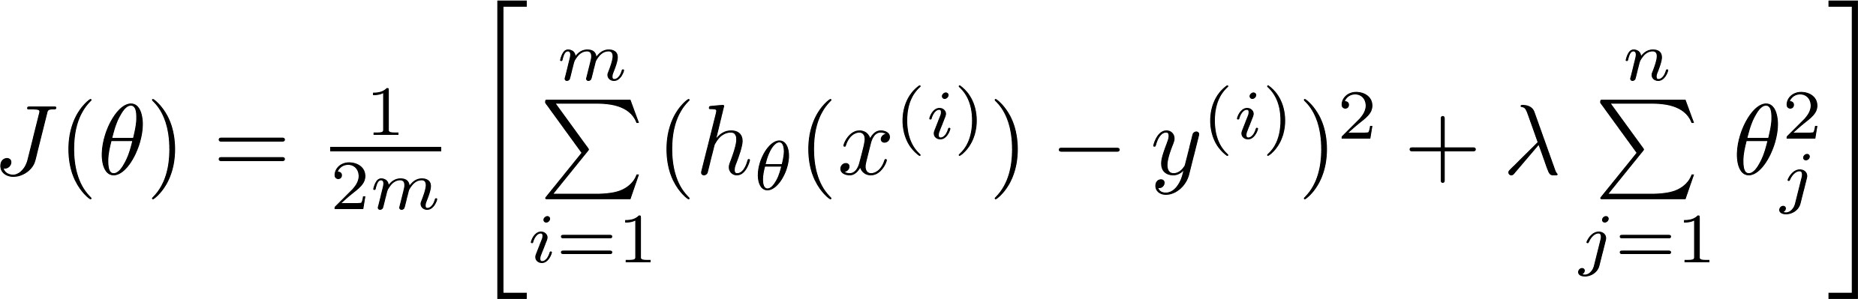
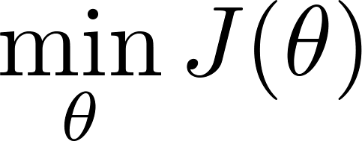
Regularization.
Price
Size of house

Slide 15


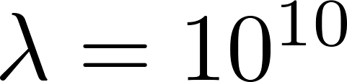
In regularized linear regression, we choose to minimize
What if is set to an extremely large value (perhaps for too large for our problem, say )?
Algorithm works fine; setting to be very large can’t hurt it
Algorithm fails to eliminate overfitting.
Algorithm results in underfitting. (Fails to fit even training data well).
Gradient descent will fail to converge.

Slide 16
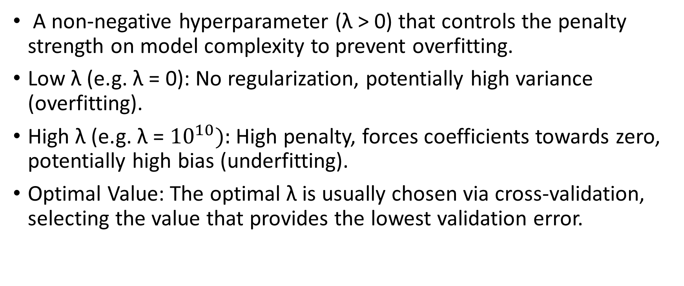
Regularization rate (λ)
A non-negative hyperparameter (λ > 0) that controls the penalty strength on model complexity to prevent overfitting.
Low λ (e.g. λ = 0): No regularization, potentially high variance (overfitting).
High λ (e.g. λ = ${10}^{10}):$ High penalty, forces coefficients towards zero, potentially high bias (underfitting).
Optimal Value: The optimal λ is usually chosen via cross-validation, selecting the value that provides the lowest validation error.

Slide 17
Regularization Regularized linear regression
Source: https://www.coursera.org/learn/machine-learning

Slide 18
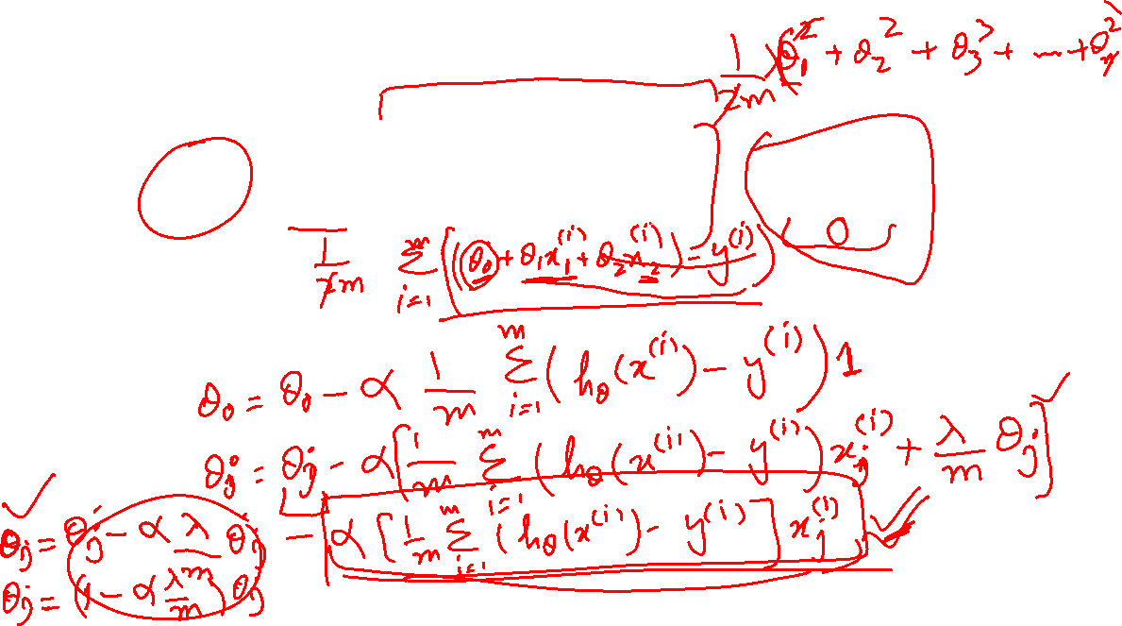
Regularized linear regression

Slide 19

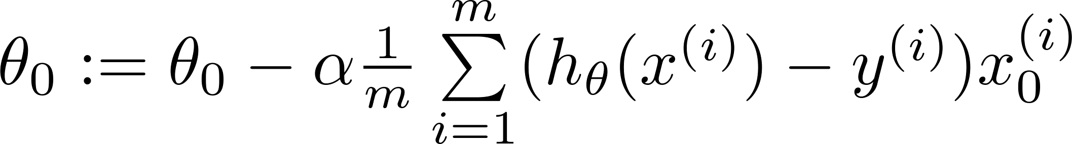
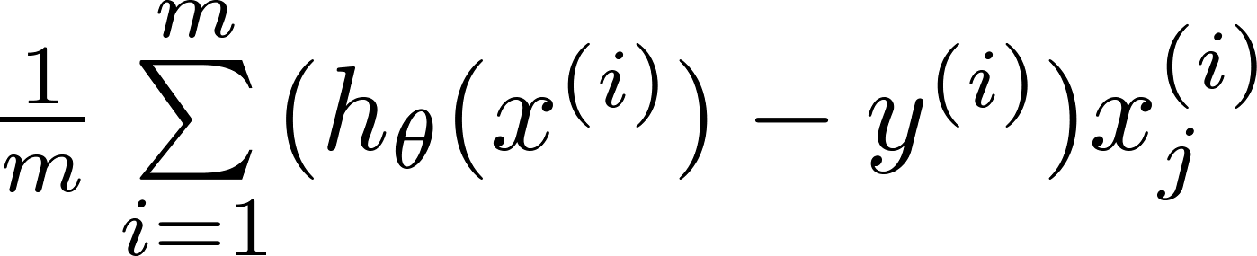
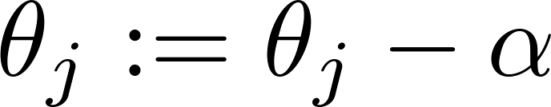


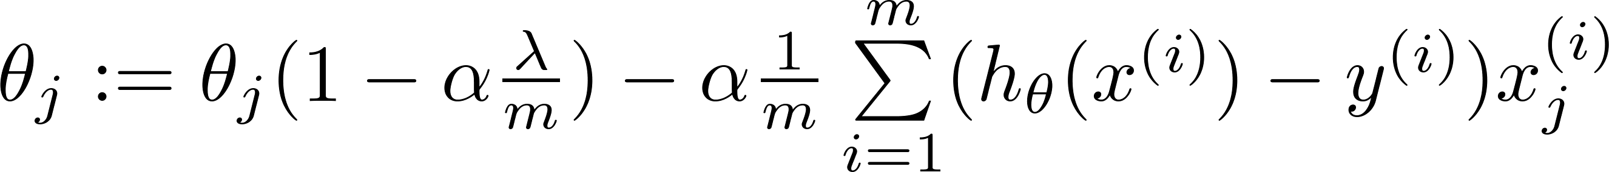
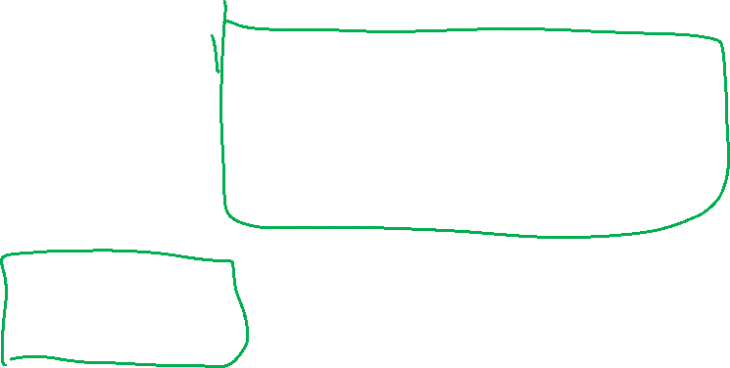
Gradient descent
Repeat

Slide 20
Regularization Regularized logistic regression
Source: https://www.coursera.org/learn/machine-learning

Slide 21
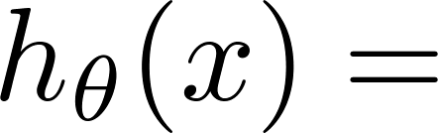
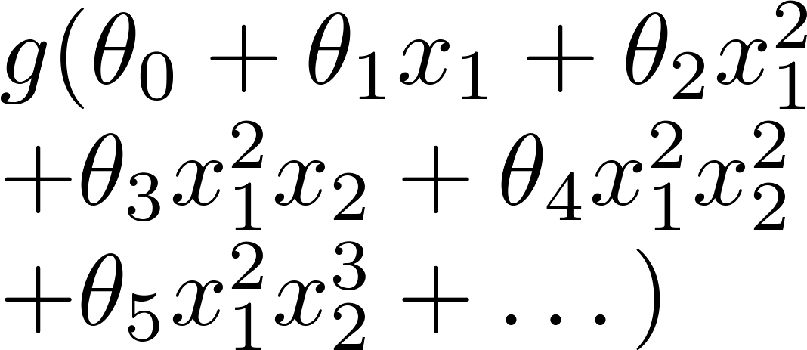
Regularized logistic regression.
x₂
x₁
Cost function:

Slide 22
Gradient descent
Looks cosmetically the same as linear regression, except obviously the hypothesis is very different.
Repeat

